Slide 1

OData ( open DATA Protocol )
Ram Niwas
LinkedIn :-
www.linkedin.com/in/ram-niwas-04
First OData Project

Slide 2
What is ODATA?
OData (Open Data Protocol) :-
It is an ISO/IEC approved, OASIS standard that defines a set of best practices for building and consuming RESTful APIs.

Slide 3



API(Application Programming interface)
APIs are mechanisms that enable two software components to communicate with each other using a set of definitions and protocols. Ex :- Weather API
Application :- It refers to any software with a distinct function
Interface :- contract of service between two applications
Client
API
Server
Request
Response
Users
Resources
Customer waiter chef
Notes:
Clients : Clients are users who want to access information from the web. The client can be a person or a software system that uses the API
Resources : Resources are the information that different applications provide to their clients. Resources can be images, videos, text, numbers, or any type of data.

Slide 4
There are four different ways that APIs can work
SOAP APIs :- XML , Used in past
RPC APIs :- Remote Procedure Calls
WebSocket APIs :- Uses JSON objects , Two-Way Communication
REST APIs :- Most Popular

Slide 5
REST API
Representational State Transfer (REST) :- It is a software architecture that imposes conditions on how an API should work
Principles of the REST architectural style
Uniform interface
Statelessness
Layered system
Cacheability
Code on demand

Slide 6
Uniform interface
It indicates that the server transfers information in a standard format. The formatted resource is called a Representation in REST.
Requests should identify resources by using URI.
Clients have enough information in the resource representation to modify or delete the resource if they want to. The server meets this condition by sending metadata that describes the resource further.
www.linkedin.com/in/ram-niwas-04
Client
Restful API
Server
Users
Resources

Slide 7
Uniform interface
Clients receive information about how to process the representation further. The server achieves this by sending self-descriptive messages that contain metadata about how the client can best use them.
Clients receive information about all other related resources they need to complete a task. The server achieves this by sending hyperlinks in the representation so that clients can dynamically discover more resources.
Client
Restful API
Server
Users
Resources

Slide 8
Statelessness
In REST architecture, statelessness refers to a communication method in which the server completes every client request independently of all previous requests.
Client
API
Server
Users
Resources

Slide 9
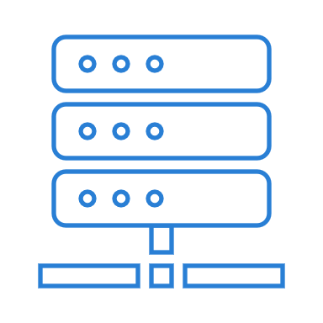
Layered system
In a layered system architecture, the client can connect to other authorized intermediaries between the client and server, and it will still receive responses from the server.
Client
API
Intermediate system
Server
Users
Resources

Slide 10
Cacheability
RESTful web services support caching, which is the process of storing some responses on the client or on an intermediary to improve server response time.
Example: -Website common header and footer images on every page.
RESTful web services control caching by using API responses that define themselves as cacheable or noncacheable.
Client
Restful API
Server
Users
Resources

Slide 11
Code on demand
In REST architectural style, servers can temporarily extend or customize client functionality by transferring software programming code to the client.
For example, when you fill a registration form on any website, your browser immediately highlights any mistakes you make, such as incorrect phone numbers. It can do this because of the code sent by the server.
Client
Restful API
Server
Users
Resources

Slide 12
ODATA REST API
Representational State Transfer (REST) :- It is a software architecture that imposes conditions on how an API should work
Principles of the REST architectural style
Uniform interface
Statelessness
Layered system
Cacheability
Code on demand

Slide 13
OData as Web-SQL.
Client
API
Server
Users
Resources
serviceRoot/Airports?$select=Name, IcaoCode
serviceRoot/People('scottketchum')/Trips?$orderby=EndsAt desc

Slide 14
Remote API vs Web API
Remote API :- Remote APIs are designed to interact through a communications network. By remote, we mean that the resources being manipulated by the API are somewhere outside the computer making the request
Web API :- Communications network (WWW)
All web services are APIs, but not all APIs are web services.

Slide 15
What does the RESTful API client request contain?
Unique resource identifier:-URI=> (URL-Location + URN-Name )
https://www.linkedin.com/in/ram-niwas-04/
https://services.odata.org/v4/northwind/northwind.svc/
HTTP Method :- GET, POST, DELETE, PUT, PATCH
HTTP headers

Slide 16
What does the RESTful API server response contain?
Status line :-
1XX :- Informational – Processing 102
2XX :- Success - Ok 200, Ok Created 201
3XX :- Redirection - Moved to new URL 301
4XX :- Client Side Error – Bad Request 400
5XX :- Server Side Error – Not Implemented 501
https://www.restapitutorial.com/httpstatuscodes.html
Message body :- Contains the resource
representation
Header

Slide 17
How do RESTful APIs work?
The client sends a request to the server. The client follows the API documentation to format the request in a way that the server understands.
The server authenticates the client and confirms that the client has the right to make that request.
The server receives the request and processes it internally.
The server returns a response to the client. The response contains information that tells the client whether the request was successful. The response also includes any information that the client requested.

Slide 18
What is ODATA?
OData is a Web protocol based on REST, for querying and updating data,
Applying and building on Web technologies such as
HTTP,
Atom Publishing Protocol (AtomPub),
and RSS (Really Simple Syndication)
Provide access to information from a variety of applications.

Slide 19
OData as being the combination of two essential parts
Format :- Defines how data is described, how it is serialized
Protocol :- Defines how that data is manipulated
Format
OData
Protocol

Slide 20
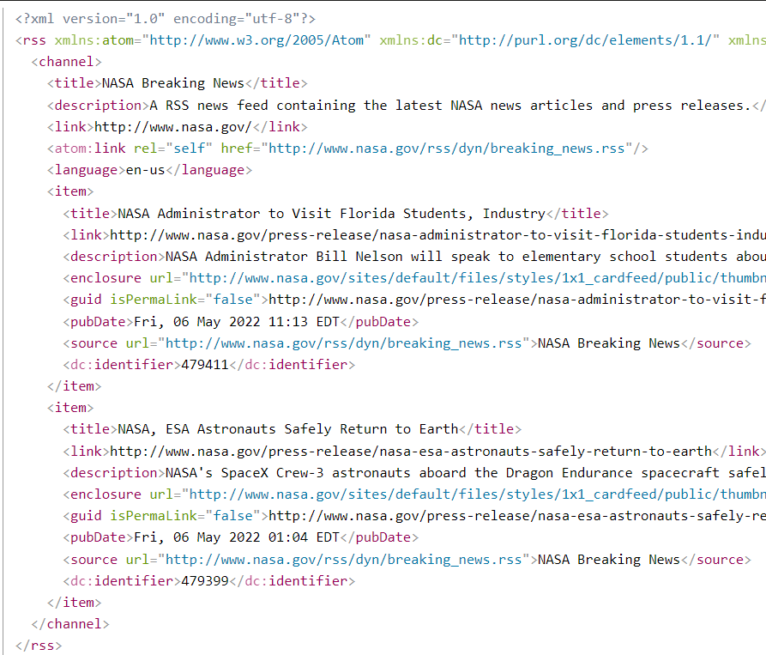
Origin of ODATA format
Weblogs, blogging and syndication.
Rich Site Summary (RSS) format

Slide 21
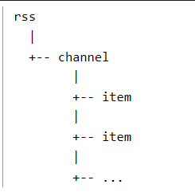
Origin of ODATA format
Think of this overall structure like a document, with a header and items.
RSS is also known as “RDF Site Summary” or “Really Simple Syndication”

Slide 22
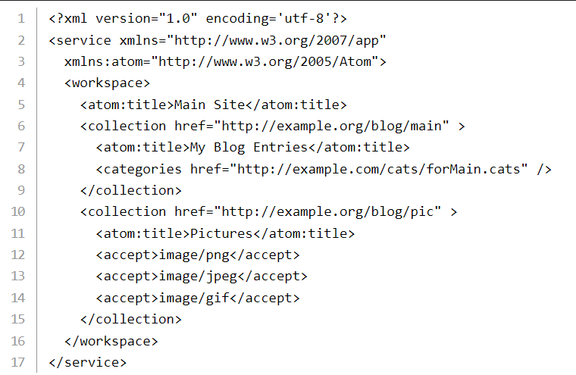
Origin of ODATA format and protocol
Atom Syndication Format
Atom Publishing Protocol

Slide 23
OData has:
A service document describing the data available in a given OData service
The concept of entity sets and entities, which are direct parallels of feeds and entries, respectively, in RSS and Atom
A basic set of operations: Create, Read, Update, Delete and Query (commonly referred to as CRUD+Q)

Slide 24
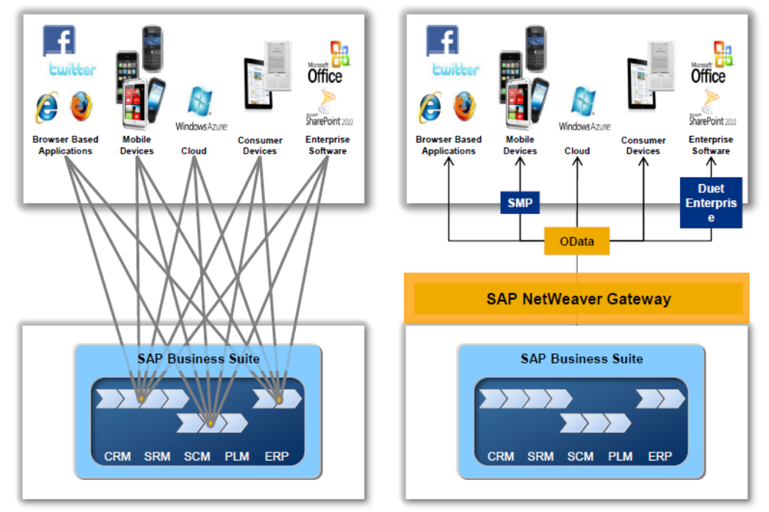
SAP NetWeaver Gateway
Point-to-point solutions drawbacks:-
Development effort,
Increased cost,
Complex landscape,
Poor scalability
Difficult to maintain.

Slide 25
Gateway Addons
GW_CORE (OData libraries)
IW_FND (runtime component, metadata store, shared services)
IW_BEP (business enablement provisioning)
IW_HDB (business content adapter for SAP Gateway with SAP HANA to enable exposure of SAP HANA views)

Slide 26
The core component for SAP Gateway Foundation
SAP NetWeaver below 7.4
Register and maintain OData Serice
GW_CORE
IW_FND
To develop the OData Service
IW_BEP (business enablement provisioning)
SAP NetWeaver 7.4 and higher
Develop, resister and maintain OData service
SAP_GWFND
GW_CORE (OData libraries)
IW_FND (runtime component, metadata store, shared services)
IW_BEP (business enablement provisioning)
IW_HDB (business content adapter for SAP Gateway with SAP HANA to enable exposure of SAP HANA views)

Slide 27
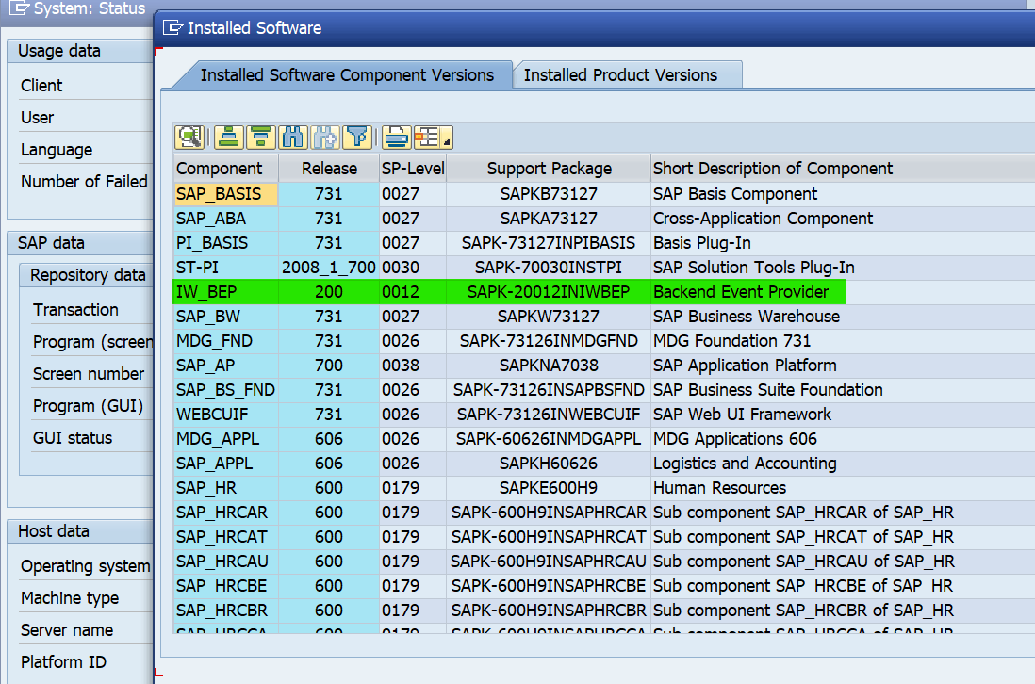
Below 7.4 for backend system

Slide 28
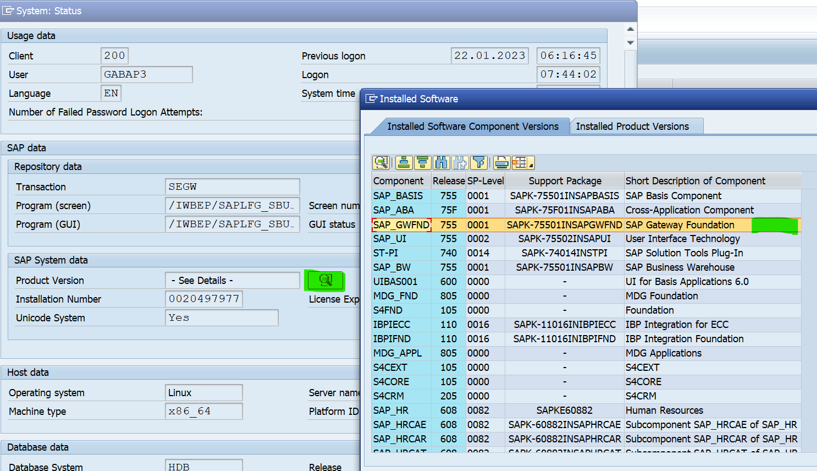
SAP NetWeaver 7.4 and higher

Slide 29
OData Deployment Option
Central Hub Deployment
Service development in the SAP Business Suite backend system)
Service development in SAP Gateway Foundation hub system
Embedded Deployment

Slide 30
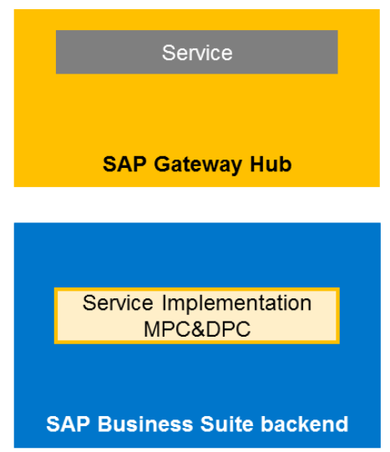
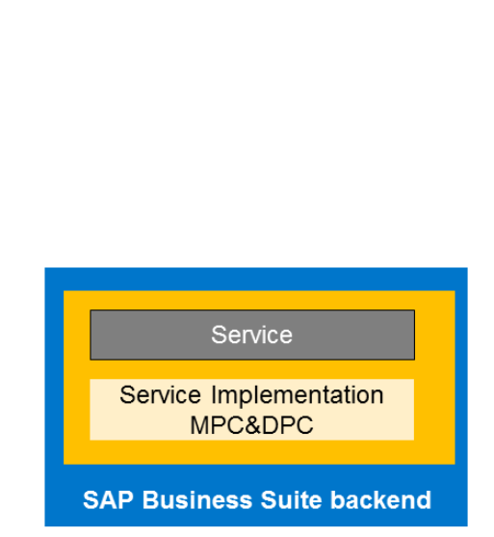
OData Deployment Option
GW_CORE,IW_FND
GW_CORE,IW_FND
IW_BEP
IW_BEP

Slide 31
OData Deployment Option
SAP_GWFND
SAP_GWFND
SAP_GWFND

Slide 32
Central Hub Deployment
Routing and composition of multiple systems is supported.
Dedicated SAP Gateway Foundation content is available
Decoupled lifecycle of consumer applications from the SAP Business Suite system.
SAP Gateway Foundation capabilities need to be deployed only once within the landscape.
Single point of access to backend systems
Enhanced security because of no direct access to the backend system
Independent innovation speed of SAP Gateway Foundation and the connected SAP Business Suite systems.
GW_CORE,IW_FND
IW_BEP

Slide 33
Embedded Deployment
Less runtime overhead as one remote call is reduced
No additional, separate SAP Gateway Foundation system required
Lower total cost of ownership as there is one less system to maintain.
The innovation speed of SAP Gateway Foundation and the SAP Business Suite system need to be synchronized.
Cross-system composition is not advisable
Central SAP Gateway Foundation content is not available. Content specific to SAP Business Suite is used in SAP Business Suite system.

Slide 34
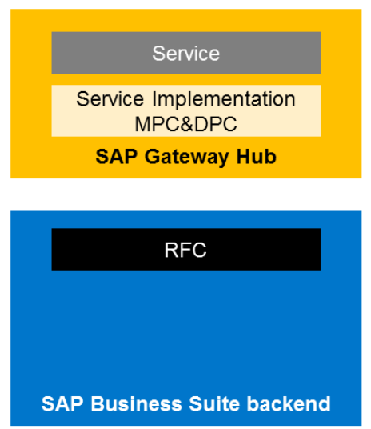
Central Hub Deployment Variant
GW_CORE,IW_FND
IW_BEP
GW_CORE,IW_FND
IW_BEP

Slide 35
Central Hub Deployment
GW_CORE,IW_FND
IW_BEP
Access is limited to remote enabled interfaces (RFC function modules, BAPI’s, BW Easy Queries, SPI Objects)
Classes we can’t access remotely
Additional server needed for Gateway
NO direct local access to metadata (DDIC) and business data in the service implementation. This means that reuse of data is limited to remote access as mentioned above

Slide 36
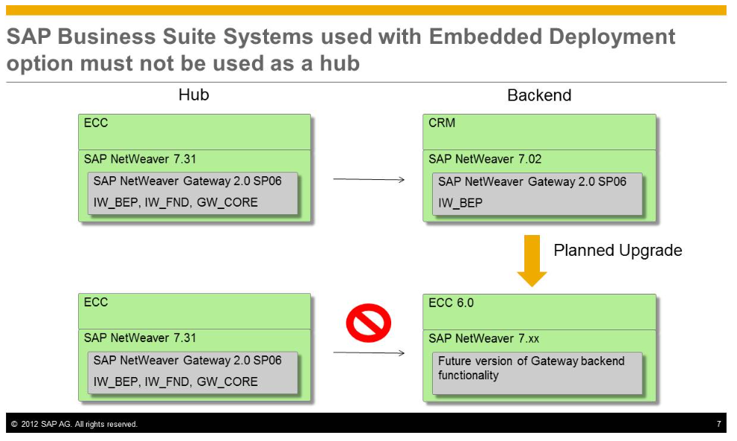
Do NOT use a SAP Business Suite System with Do NOT use a SAP Business Suite System with embedded deployment as a hub system for additional backend systems

Slide 37
Central Hub Deployment

Slide 38
Central Hub Deployment

Slide 39
First OData service in ABAP
Getting Started with the Service Builder
Creating a Project -> SEGW (SAP Gateway Service Builder)
Project name must not exceed 30 characters and must not start with a number or include any special characters

Slide 40
Gateway Addons
Belo 7.4
Above OR equal 7.4
GW_CORE
IW_FND
SAPGW_FND
IW_BEP
SAPGW_FND

Slide 41
What are the benefits of RESTful APIs?
Scalability
Flexibility
Independence

Slide 42
OData ( open DATA Protocol )
Ram Niwas
LinkedIn :-
www.linkedin.com/in/ram-niwas-04
Association and Navigation

Slide 43
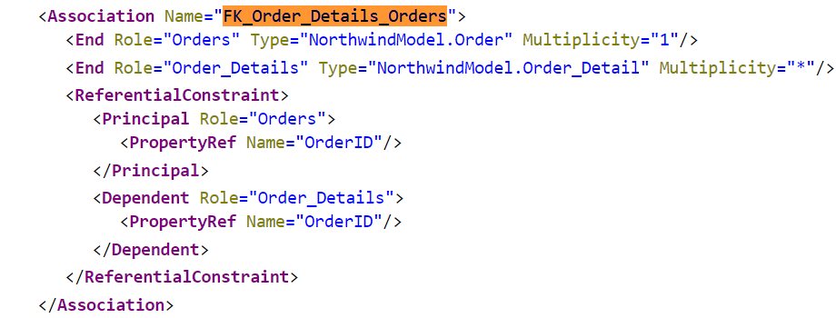
Associations
Associations :- Associations define the relationship between two or more Entity Types

Slide 44
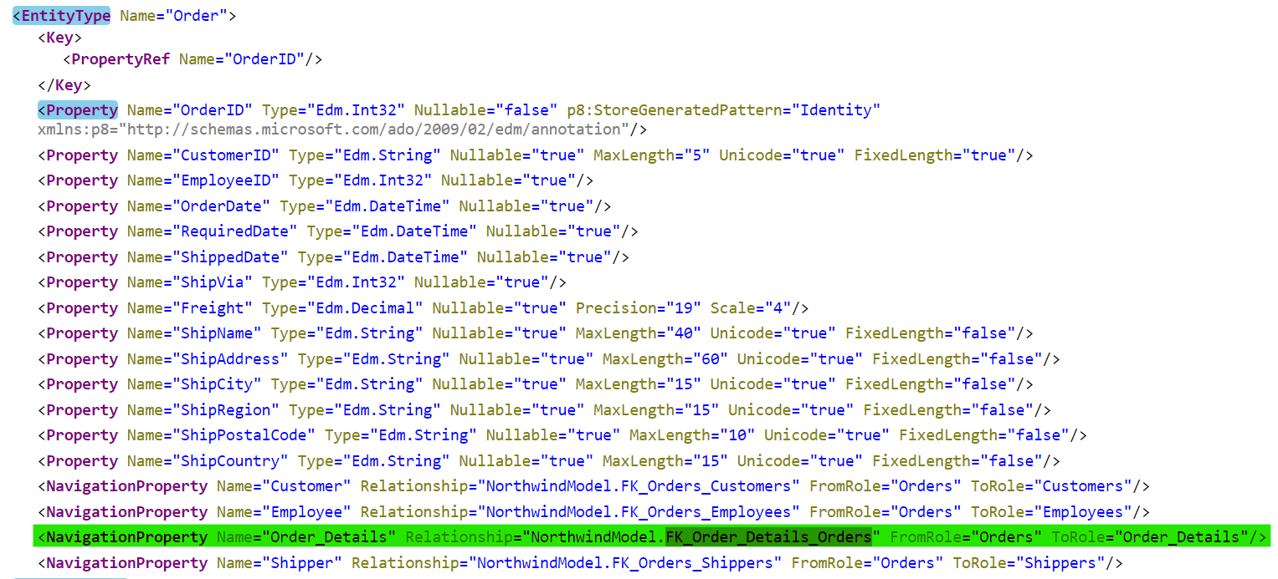
Navigation Properties :- Special properties on Entity Types which are bound to a specific association and can be used to refer to associations of an entity.

Slide 45
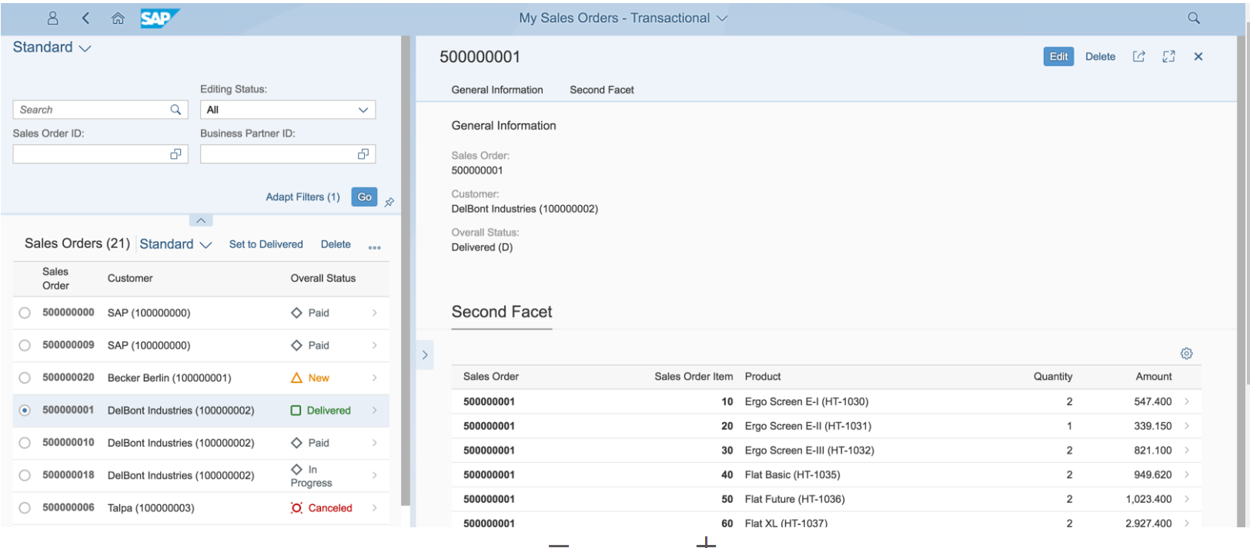
SAP Fiori master detail application sales order

Slide 46
OData ( open DATA Protocol )
Ram Niwas
LinkedIn :-
www.linkedin.com/in/ram-niwas-04
Deep insert

Slide 47
Expand Query option
OData query option $expand is used to read multiple entities or entity sets in a single service call instead of two different calls
/sap/opu/odata/sap/ZSALESORDER_002_SRV/
SalesOrderHeaders?$expand=Items&$format=json
Explicit implementation is not required to use $expand query option.
salesorderheader_get_entityset -> salesorderitems_get_entityset

Slide 48
Navigation Vs Expand Query
The main difference is that a navigation returns the navigation target only.
Expand is an expansion of the original source, i.e. you get the source entity plus the requested expansion inline as one response.

Slide 49
SAP Recommendation
Do use $expand/deep insert for associated entity types when you need to fetch or create deep data.
$expand is the possibility of OData to make ‘joins’.
Deep inserts are the possibility to make updates on views.
Do use $expand/deep insert for more data which contains more than one association call.

Slide 50
SAP Recommendation
$expand reduces roundtrips from the client to the SAP Gateway server as well as the SAP Gateway server to the SAP Business Suite. As a result, network time is reduced.
$expand reduces SAP Gateway server response time and the consumption of resources.
Basic $expand implementation can reduce the SAP Business Suite times, because the number of database operations and the application logic can be reduced.

Slide 51
OData ( open DATA Protocol )
Ram Niwas
LinkedIn :-
www.linkedin.com/in/ram-niwas-04
OData Query Option :-
$top $skip $inlinecount

Slide 52
OData Query Options
They are automatically available in the framework, no further actions needed by development.
$select
$count
$expand
$format
Read $links
$value

Slide 53
OData Query Options
They are available, but they require implementation efforts from development.
$orderby
$top
$skip
$filter
$inlinecount
$skiptoken

Slide 54
The $filter query supports the following logical operators:
eq (equals)
gt (greater than)
lt (less than)
ge (greater than or equals)
le (less than or equals)
ne (not equal)
and (logical and)
or (logical or)

Slide 55
Filter
URL-encode any special characters in the $filter expression
code eq '[1000005] => code eq '%5B1000005%5D'
Add M after any decimal value.
For example, 4.1M.

Slide 56
Batch Call Processing
What is batch call processing?
What is $batch use?
Do $batch query need any implementation?
Create work list Fiori app and see how the service called?

Slide 57
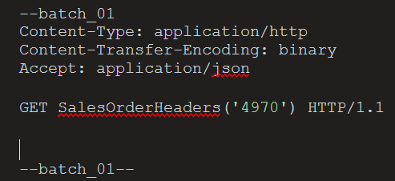
$batch
Batch Request :- Here you define all the operations which need to be performed, in one payload and submitted as a single HTTP POST request
/sap/opu/odata/sap/ZSALESORDER_002_SRV/$batch
HTTP Post method
Header request :- Content-Type multipart/mixed; boundary=batch
Your service call detail in pay load

Slide 58
OData ( open DATA Protocol )
Ram Niwas
LinkedIn :-
www.linkedin.com/in/ram-niwas-04
OData Query Option :-
$batch

Slide 59
Why $batch
Batch processing -Enables multiple retrieval operation in a single HTTP request in parallel.
The CHANGESET request can be posted along with GET request but it will not be processed parallelly.
Create
Read
/ $batch + HTTP Post request
Update
Delete

Slide 60
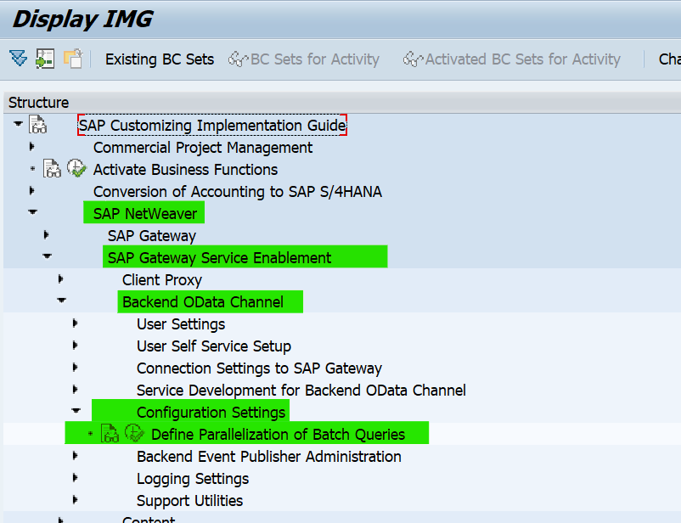
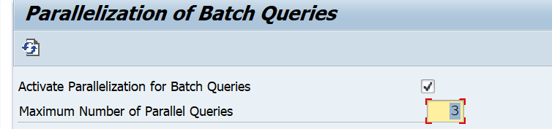
$batch parallelization
Maximum no -No of batch queries that can be executed in parallel.
It is always recommendable to give the no of parallel process keeping the system performance in time-Because based on the number the existing work process will be allocated for processing the job

Slide 61
$batch parallelization
3 GET Request ,
2 POST Request,
1 PUT request,
1 DELETE request.
Only the GET requests will be executed in parallel.
This number of maximum parallel processing request will be voided if the available work process in system is low for parallel processing.
3 GET Request
1 POST request
1 POST request
1 PUT request
1 DELETE request.

Slide 62
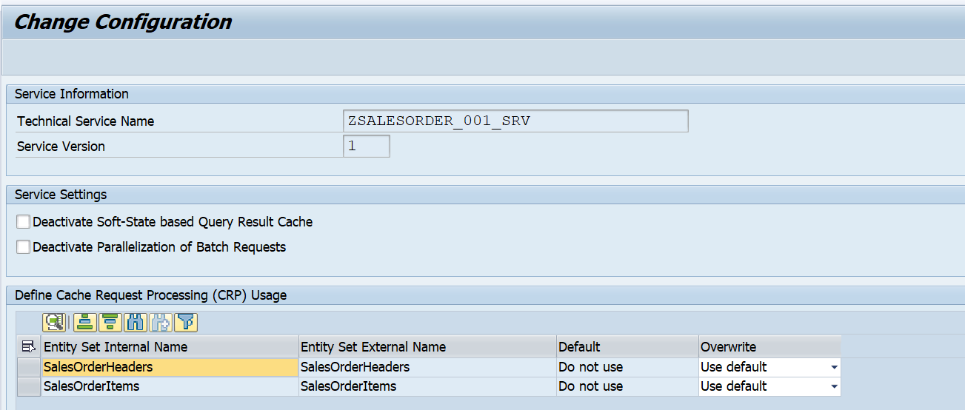
$batch parallelization
/IWBEP/CONF_SERVICE :- Retrieve operations within a $batch are processed using parallelization by default. The setting to enable/disable parallelization for a particular service can be done via

Slide 63
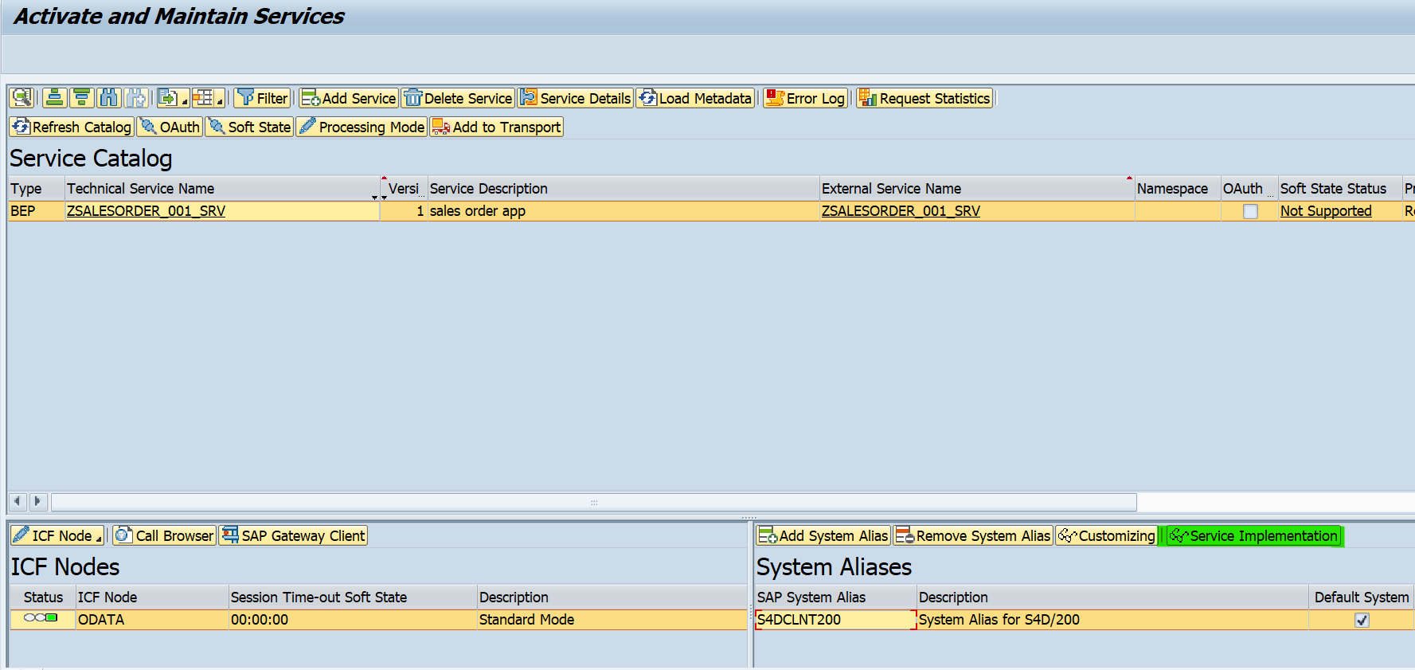
$batch parallelization
/IWFND/MAINT_SERVICE :- The setting is also available from via: Service Implemenation ->click configuration

Slide 64
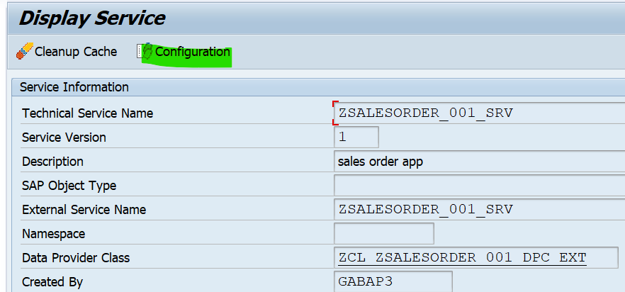
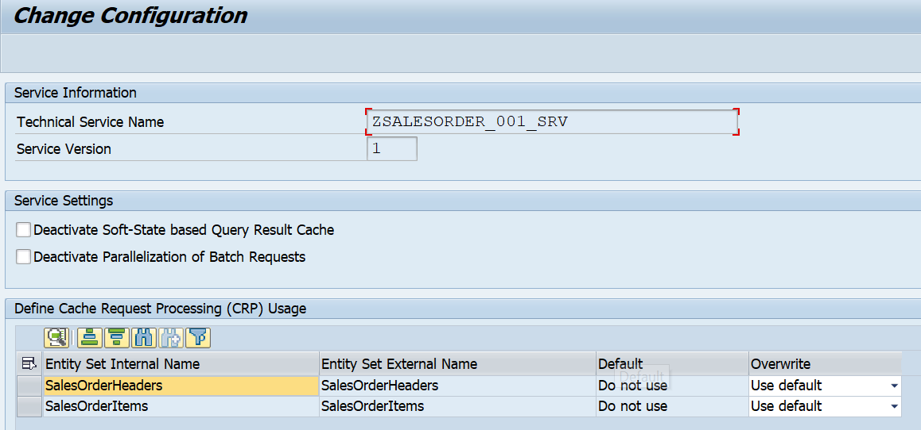
$batch parallelization
/IWFND/MAINT_SERVICE :- The setting is also available from via: Service Implemenation ->click configuration
This parallel query process will be executed only for Local and frontend system which has only one registered backend system.
When you use Multi Origin Composition with multiple backend system , the parallel query process will not be triggered each and every request will be processed separately

Slide 65
$batch changeset
A Change set is unordered group of one or more insert, update or delete operations. Retrieve operation is not a change set.
We can use one or more Update/delete/insert operation within a “Changeset”, make sure there is no “Commit work” statement within any one UPDATE/CREATE/DELETE entity. If it exists, the system will dump the request and no further processing will happen.
If an operation within a changeset fails, the batch response body contains only one single response for this changeset indicating the failure of the entire changeset. Changeset process will be single LUW.
Every change set is treated as separate LUW ensuring the “ALL” or “Nothing” transaction behavior
If there are 2 Change sets with some operations
within it, that implies processing of 2 LUW

Slide 66
--batch_01
Content-Type:multipart/mixed; boundary=changeset
--changeset
Content-Type: application/http
Content-Transfer-Encoding: binary
PUT EmployeeSet(12) HTTP/1.1
Content-Type: application/json
{
"EmployeeId" : 12,
"Name" : "Ram",
"City" : "New Jaipur 1",
"CompanyName" : "SAP Technomaniac",
"Department" : "SAP Technomaniac",
"StratDate" : "\/Date(1643500800000)\/",
"EndDate" : "\/Date(1706054400000)\/",
"Salary" : "2400000.00",
"Currency" : "INR"}
--changeset
Content-Type: application/http
Content-Transfer-Encoding: binary
DELETE EmployeeSet(12) HTTP/1.1
--changeset--
--batch_01
Content-Type:multipart/mixed; boundary=changeset2
--changeset2
Content-Type: application/http
Content-Transfer-Encoding: binary
DELETE EmployeeSet(10) HTTP/1.1
--changeset2--
--batch_01--

Slide 67
$batch changeset
The change sets internally are handled by 2 API methods :-
CHANGESET_BEGIN – by default allows only 1 operation per change set
CHANGESET_END – finalization of modification updates occurs here. The framework issue a commit work at the end of this method.

Slide 68
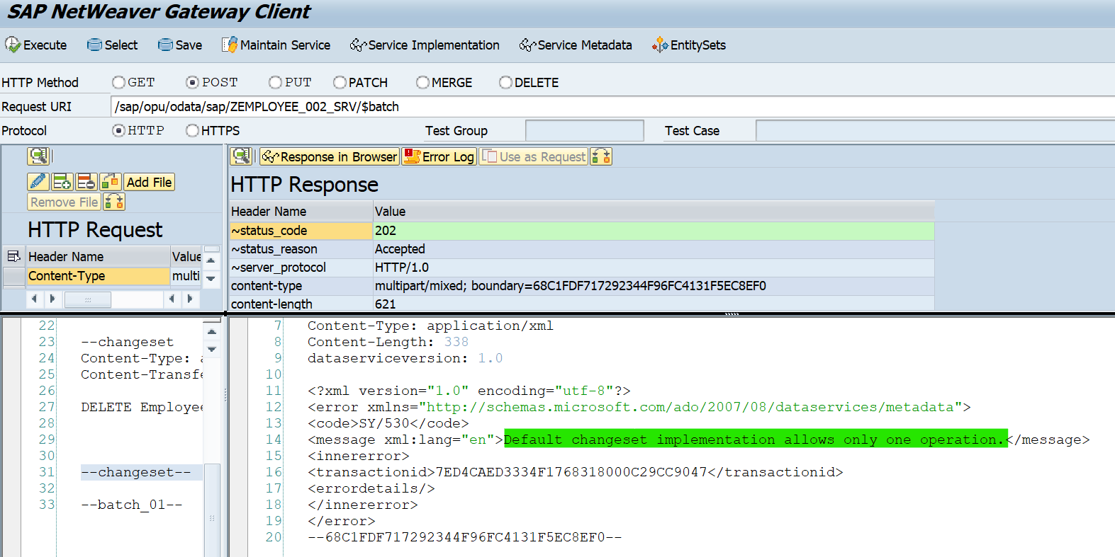
$batch changeset

Slide 69
$batch changeset
--batch_01
Content-Type:multipart/mixed; boundary=changeset
--changeset
Content-Type: application/http
Content-Transfer-Encoding: binary
PUT EmployeeSet(12) HTTP/1.1
Content-Type: application/json
{
"EmployeeId" : 12,
"Name" : "Ram",
"City" : "New Jaipur 2",
"CompanyName" : "SAP Technomaniac",
"Department" : "SAP Technomaniac",
"StratDate" : "\/Date(1643500800000)\/",
"EndDate" : "\/Date(1706054400000)\/",
"Salary" : "2400000.00",
"Currency" : "INR"}
--changeset
Content-Type: application/http
Content-Transfer-Encoding: binary
DELETE EmployeeSet(12) HTTP/1.1
--changeset--
--batch_01--

Slide 70
$batch - defer mode
SAP 740 SP09 Batch processing, performance has been improved by introducing new API for Changeset processing in defer mode
The defer mode processing is introduced to achieve performance by handling multiple operations within a change set.

Slide 71
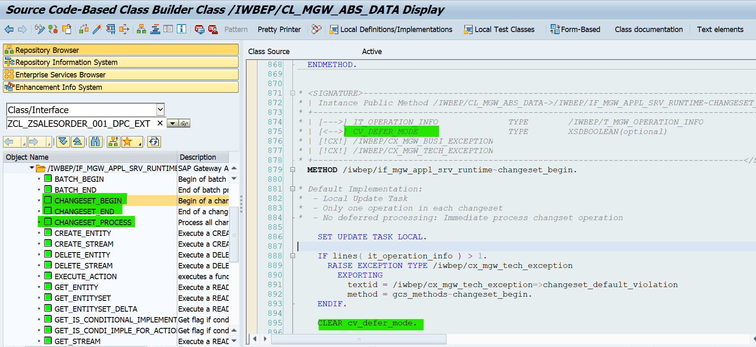
$batch - defer mode
CV_DEFER_MODE = ABAP_TRUE.

Slide 72
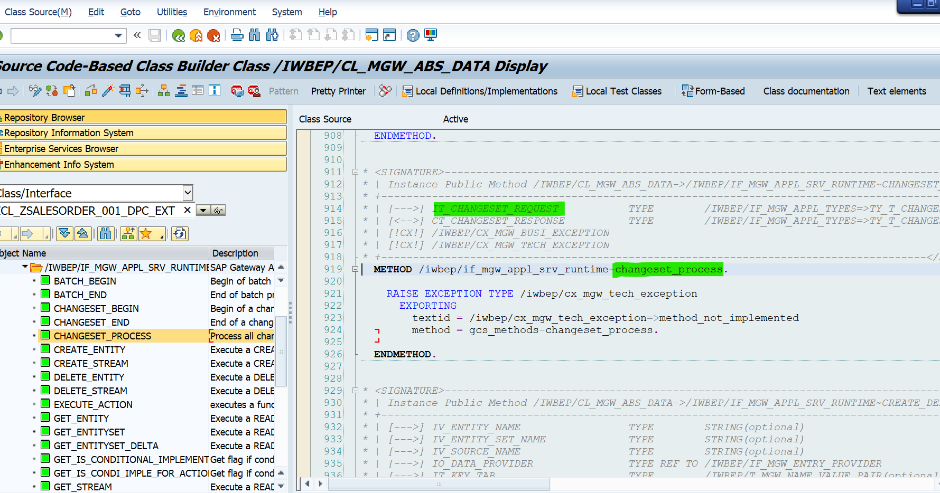
$batch - defer mode
Show in system

Slide 73
$batch - defer mode
CHANGESET_BEGIN :- Set the defer mode = ‘X’ . This is an indicator that backend data provider is able to handle more than one operations at once.
CHANGESET_PROCESS :- The backend data provider will process multiple operations using a new method. Ensure no commit is called within the LUW to respect ALL or Nothing principle.
CHANGESET_END:- At the end of change set, method is called. The framework issues a commit work to perform the database updates here.

Slide 74
Correction :-
If you make defer mode = ‘X’ it will not call DELETE_ENTITY, MODIFY_ENTITY, UPDATE_ENTITY and CREATE_ENTITY methods
GET_ENTITY any way not triggered by change set

Slide 75
Performance
Do use $batch to send the data of several requests in a single HTTP request from the client to the SAP Gateway server for entity types that are not associated:
Do use parallel calls in case of two Read calls or two Update calls with multiple atomic units of work (different change sets). As an alternative to two parallel calls, you can consider using $batch.
Do use $batch in case of more than two calls without associated entity types (do not make too many client – SAP Gateway server roundtrips).

Slide 76
Performance optimizations and considerations
$batch reduces the number of roundtrips between the end-user and the SAP Gateway server. As a result, network time is reduced.
$batch reduces the number of roundtrips from the SAP Gateway server to the SAP Business Suite to one in case of Update calls with a single atomic unit of work.
$batch reduces SAP Gateway server response time and the consumption of resources.
$batch reduces CPU time of the SAP Business Suite in case of Update calls with a single atomic unit of work.

Slide 77
Performance optimizations and considerations
Consider the balance between the number of roundtrips and the payload size. A payload size which is too big can affect the network time due to bandwidth constraints.
Consider using $batch because it can have a negative impact on the response time since SAP Gateway calls SAP Business Suite/s in sequential order (in case of Read calls or Update calls with multiple atomic units of work).

Slide 78
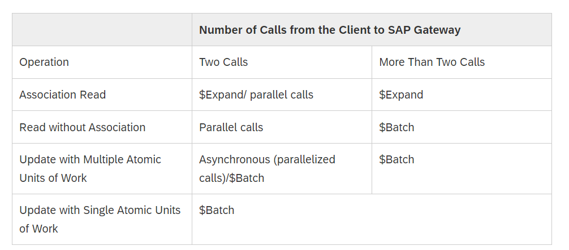
The following table can help to choose the required option between $expand, $batch and parallel calls.

Slide 79
OData ( open DATA Protocol )
Ram Niwas
LinkedIn :-
www.linkedin.com/in/ram-niwas-04
OData Query Option :-
$skiptoken

Slide 80
OData ( open DATA Protocol )
Ram Niwas
LinkedIn :-
www.linkedin.com/in/ram-niwas-04
Function Import

Slide 81
Function Import
Anything that cannot be mapped to the standard CRUD operations we do through function import
Function imports may be used for operations other than CRUD, such as Approve, Reject, Reserve, and Cancel.
For example :-
Confirm Work Item
Check Flight Availability
Get sales order status count
Release, Approve PO/SO

Slide 82

Practice in the system

Slide 83
Function Import
Don't use HTTP method name (such as GET as prefix, suffix or infix). For example, GetProductByRating
Do use ProductsByRating.
Do use appropriate HTTP method. A GET method must have a return type. Post should have parameters.
If you find yourself inventing function imports such as CreateX, ReadX, GetX, ChangeX, UpdateX, or DeleteX, you should make the entity type X part of your model.

Slide 84
OData ( open DATA Protocol )
Ram Niwas
LinkedIn :-
www.linkedin.com/in/ram-niwas-04
Media Handling

Slide 85
Media Handling
Image, Audio, Video, PDF, ZIP, Excel Sheet, Text Files
The OData Channel provides a generic solution for exposing binary data that is stored in an SAP Business Suite backend system and should be accessible using a media link entry.
Based on the media type classification, the OData Service Metadata Document sets the hasStream to true for the resulting EntityType.
The property which contains the source URI is annotated by the application developer by using method SET_AS_CONTENT_TYPE

Slide 86
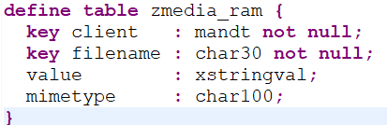
Media Handling
Create Table in SE11
Create Media Entity
Set the filename property as a content type in MDC EXT Class
Implement create_stream, update_stream, delete_stream, get_stream

Slide 87
OData ( open DATA Protocol )
Ram Niwas
LinkedIn :-
www.linkedin.com/in/ram-niwas-04
ETAG & Concurrency Control

Slide 88
Concurrency Control
Concurrency – Accessing/Updating a resource at same time by different users
It causing confusion among the users and inconsistency in the expected output.
Such situation handled by Concurrency Control
Concurrency Control types
Pessimistic concurrency control
Optimistic concurrency control
Semi-­optimistic concurrency control

Slide 89
Pessimistic concurrency control
Pessimistic concurrency assumes that conflicts between transactions can happen often and blocks data records when a user starts to update. So, other users will not be able to update that data until the lock is released.
In this scenario the application assumes that concurrent writes will occur so often and hence we need to aggressively protect w/o being edited by multiple requests at same time using pessimistic locks.
This will normally involve a performance reduction
Dead lock can occur

Slide 90
Optimistic concurrency control
In this scenario the application assumes that the likelihood of a concurrent write is rare and allow operations to continue and lock resources for very small period of time.
So all the operations in the transaction are attempted and rolled back if one fails.

Slide 91
Semi-optimistic concurrency control
This is a blend of the pessimistic and optimistic concurrency controls
It is possible to get higher throughput by managing the resource locks individually
These are normally for very specific use

Slide 92
Example without Concurrency control
Before state
SAP Technomaniac -> Technomaniac
USER 1
Jaipur -> Bangalore
USER 2

Slide 93
Example without Concurrency control
After state
SAP Technomaniac -> Technomaniac
USER 1
Jaipur -> Bangalore
USER 2

Slide 94
Potential problems of Concurrency
Lost Updates occur when multiple transactions select the same row and update the row based on the value selected
Second transaction selects a row which is updated by another transaction (dirty read)
Second transaction is trying to access the same row several times and reads different data each time.

Slide 95
ETag (Entity Tag)
ETags or entity tags are part of the HTTP protocol
They are header fields that help to determine changes of a resource
Etags are usually timestamps that are updated when an entity is updated.
For more complex scenarios however, timestamps might not be the best choice and a hashtag is the better approach.

Slide 96
User 1 With Concurrency control
USER1
Server
If-Match
PUT Req + ETAG(W/"time'PT00H00M00S'")
Server
Updated +HTTP 201
New ETAG W/"time'PT12H11M04S'"

Slide 97
User 2 with Concurrency control
USER 2
Server
Jaipur -> Bangalore
If-Match
PUT Req + ETAG(W/"time'PT00H00M00S'")
New ETAG W/"time'PT12H11M04S'"
Server
Rejected Precondition Failed
New ETAG W/"time'PT12H11M04S'"

Slide 98
User1 and User 2
User 1
API
Server
If-Match
New ETAG W/"time'PT12H11M04S'"
PUT Req + ETAG(W/"time'PT00H00M00S'"))
If-Match
User 2
PUT Req + ETAG(W/" W/"time'PT00H00M00S'") '"))
Rejected Precondition Failed

Slide 99
A few special considerations apply for ETags
When retrieving an entry, the system returns an opaque ETag value
When getting several entries in a feed, the ETag value is included as metadata in the entry itself.
When retrieving a single entry, the ETag is returned as a response header called ETag as defined by HTTP.
During processing of POST, PUT, and MERGE the system should compute a new ETag and return it in a response header

Slide 100
A few special considerations apply for ETags
When issuing a PUT, MERGE or DELETE request, clients need to indicate an ETag in the If-Match HTTP request header. If it is acceptable for a given client to overwrite any version of the entry in the server, then the value "*" may be used instead. If a given entry has an ETag and a client attempts to modify or delete the entry without an If-Match header servers should fail the request with a 412 response code.

Slide 101
Instead of using the generic framework support it is possible to perform a code based implementation in the SAP Business Suite backend system.
This has some advantages since it allows the developer to lock the data while checking the etag before the update is performed. When using the out of the box framework support this is not possible and you cannot be 100% sure that another user has updated the data in the short timeframe between the read request of the framework and your update request.
The second advantage is that a code based implementation also offers etag support for function imports

Slide 102
OData ( open DATA Protocol )
Ram Niwas
LinkedIn :-
www.linkedin.com/in/ram-niwas-04
CDS with OData

Slide 103
Build Odata Service
ABAP code-based service Implementation.
Service Adaptation Description Language (SADL) framework
Referenced Data Source/Mapping Editor
Annotation based approach (OData.publish : true)
CDS + BOPF
CDS + RAP

Slide 104
Ways to Build OData Service
Method | ABAP Platform | OData | Usage
(1) Classic ABAP programming (SEGW) | <=7.4 | V2 (4?) | SEGW, ABAP (optional CDS as source)
(2) ABAP programming model for SAP Fiori | <= 7.5 (Draft capability >= 7.51) | V2 | CDS based BOPF (optional SEGW)
(3) ABAP RESTful Programming Model (RAP) | >= 7.54 (S/4HANA 1909); SAP BTP ABAP Environment (1808) | V2,V4 | CDS, Behavior Definition & Implementation
(3a) Cloud Application Programming Model (CAP) | SAP BTP, Cloud Foundry | V2,V4 | CDS, Behavior Definition & Implementation

Slide 105
Practice in the system

Slide 106
SAP Gateway integration of CDS or BOPF Regarding the code-based implementation of OData service in transaction SEGW, we strongly recommend the use of the mapped data source option in ABAP 7.40 and referenced data source option as of ABAP 7.50, together with CDS entities.For these service implementation options, the SAP Gateway runtime offers generically the read-only OData calls including goodies like sorting, filtering and text search for CDS views out of the box.
The reference data source (RDS) option is the option used within the ABAP Programming model for SAP Fiori and is also the valid approach for the use of legacy write APIs – like BAdIs/Function modules – when building new SAP Fiori apps since this scenario is not yet supported by the ABAP programming model. This option is also to be used for cross BO scenarios.
Whenever possible make use of the SEGW RDS together with CDS.

Slide 107
DO NOT
Manual implementation of read-only OData calls to Database
Instead of implementing yourself the read-only OData calls again and again when building SAP Gateway service in transaction SEGW, use the mapped data source or -better- the referenced data source option instead
Business logic mixed with technical aspects
encapsulate the different business logic paths of a given application and decouple them from surrounding technical aspects such as locks, authority checks, LUW handling and persistency.
Business logic mixed with protocol specific APIs
Similarly to the previous recommendation, when manually implementing your SAP Gateway services in transaction SEGW, do not put your custom business logic directly in the predefined SAP Gateway extensions classes (ending with DPC_EXT), but instead decouple it, so it can be reused easily somewhere else

Slide 108
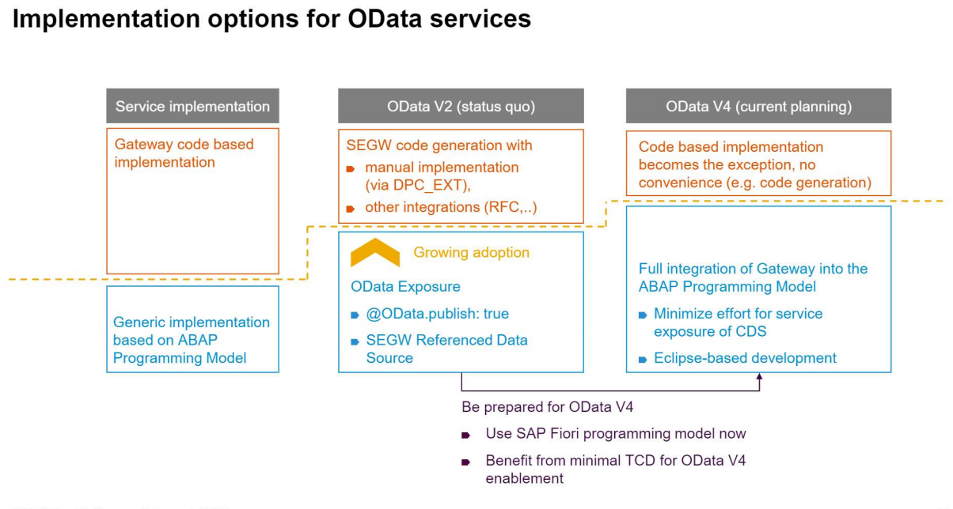

Slide 109
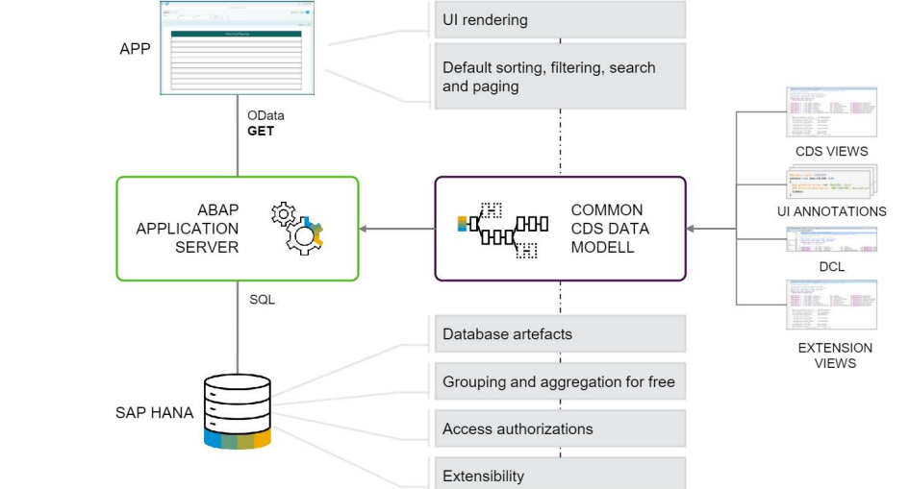

Slide 110
Use CDS as the one and only data modelling language
Use CDS and BOPF integration and get familiar with BOPF concepts like determinations, validations and actions
Use OData exposure @OData.publish:true or the Service Builder (SEGW) with Reference Data Sources for OData V2
Avoid DPC / MPC specific coding wherever possible

Slide 111

THANK YOU
CONTACT
Ram Niwas
LinkedIn :- https://www.linkedin.com/in/ram-niwas-04/
FB group :-https://www.facebook.com/groups/586730659057346/

Slide 113

THANK YOU
CONTACT
Ram Niwas
99808 33663
Ram.Niwas@accenture.com
Accenture - Bang 10
Bagmane Technology -Twr A
Bengaluru

Slide 114
Paging
Client-side paging :- The client decides how many records it wants to load and asks the server that many records.
That is achieved by using $skip and $top query options
Server-side paging :- In Server side paging, even if the client requests all the records, the server will only return a portion of the results.
Server provide a “next link” information, which can be followed to get the next portion and so on.
This we can achieve by using $skiptoken
query options.

